Slide 1
Project title SECURE DATA HIDING IN IMAGES USING STEGANOGRAPHY
Presented By: Kommara sunil kumar
Student Name : Kommara sunil kumar
College Name & Department : Giet college of engineering & Mechanical

Slide 2
OUTLINE
Problem Statement
Technology used
Wow factor
End users
Result
Conclusion
Git-hub Link

Slide 3
Problem Statement
How can we hide data in an image without significantly altering its visual quality?
What techniques can we use to make the modifications imperceptible to the human eye?
How can we prevent data loss during encoding and decoding?
Can we encrypt the data hidden data so that only authorized users can access it?
What is the best way to balance image size and hidden data capacity?
How can we make our hidden data resistant to cropping,resizing,or filtering?

Slide 4
Technology used
Programming language : Python
Image processing library : OpenCV
String library
File handling : OS
Data encoding techniques

Slide 5
Wow factors
The changes made to an image during steganography are so small that they are almost impossible to detect without specialized tools
Even when data is hidden, the image looks completely normal
We can hide text,images,audio, or even entire file inside an image
Even if someone suspects something, they still need the correct password to extract the data
Secret communication to avoid detection by hackers

Slide 6
End users
1. Cyber Security & Intelligence Agencies :
Secure communication between agents by hiding sensitive data inside images.
2. Journalists :
Protecting confidential sources and transmitting sensitive information.
3. Digital Forensics & Law :
Embedding hidden information in digital evidence (e.g., watermarking images to track suspects
4. Developers & Researchers :
Exploring new steganography techniques for secure data transmission.
5. General public & Privacy Enthusiasts
6. Enterprise Security Teams
7. Copyright holders

Slide 7
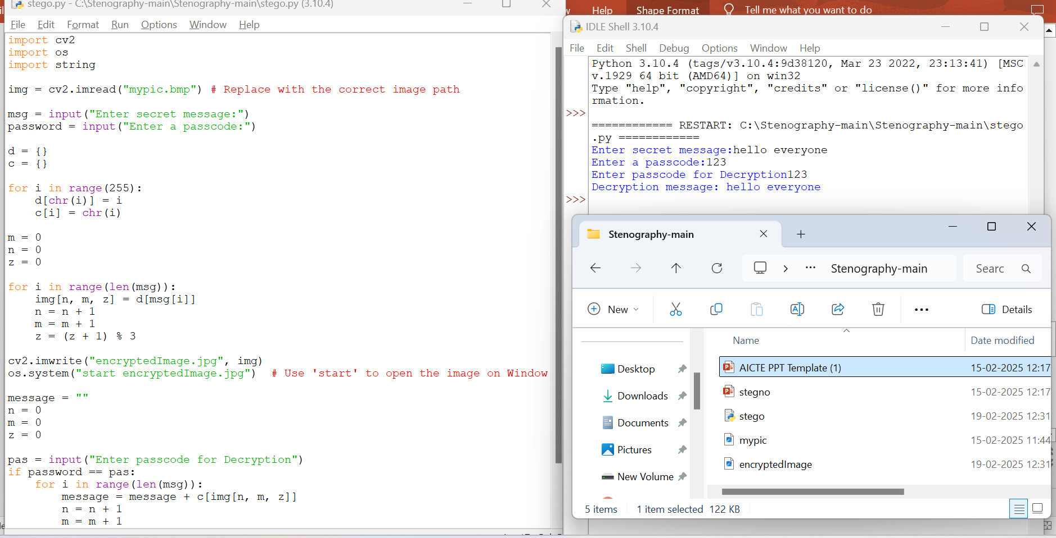
Results
Screenshots of the outcome (min 3)

Slide 8
Conclusion
Steganography allows secret messages or images to be hidden within digital images while keeping them visually unchanged.
It is useful in Cyber Security, Digital Watermarking, Forensic Investigations.
This project sets the groundwork for further exploration in convert data transmission, digital rights protection and secure messaging systems.

Slide 9
GitHub Link
https://github.com/9493952689/SECURE-DATA-HIDING-IMAGES-USING-STEGANOGRAPHY.git

Slide 10
THANK YOU

